Slide 1
Notes:
These slides are provided for Kirkpatrick Certified individuals to share the Kirkpatrick materials WITHIN THEIR OWN ORGANIZATION.
Using the materials in any other way (i.e., with clients, at trade shows, in articles, on the internet, in discussion groups, etc.) requires prior written permission from Kirkpatrick Partners.
If you are presenting a case study that is based on the four levels, you may describe the model only to the degree necessary for the audience to understand the methodology used.
Teaching the four levels and using any of the proprietary images contained in this presentation for any purpose outside of your own organization is a violation of U.S. trademark law.
If you have any questions about appropriate or inappropriate use of these materials, please contact us.

Slide 2
Authentic Kirkpatrick® Slides to Use Within Your Organization
Jim and Wendy Kirkpatrick

Slide 3
Why Evaluate?
Improve
the Program
Improve Job Performance
Maximize Organizational Results
Demonstrate relative contribution of each success factor
Effective Training
Training Effectiveness
Notes:
Reasons why we evaluate our training programs fit into two categories.
The first is what we call effective training. These are measurements used to determine if the training program was of good quality and well-received. These relate to Kirkpatrick Levels 1 and 2. These are the most common measurements.
The second category is called training effectiveness. These are measurements that show if the training program has helped people to perform effectively on the job to contribute to the highest goals and mission of an organization. This relates to Kirkpatrick Levels 3 and 4. These measurements aren’t made as often, but they are the ones most wanted by organizations and executives. This is where we believe the training industry needs to focus right now to remain viable. We also believe that your training function, and you as a training professional, must decide where you are going to put your flag in the ground. It will likely have enormous implications for your future.

Slide 4
Level 1: Reaction
The Kirkpatrick Model
The degree to which participants find the training favorable, engaging and relevant to their jobs
Notes:
Guidelines for what to do and say
If the audience is not already familiar with the four levels, use these slides to introduce them.

Slide 5
Level 2: Learning
The Kirkpatrick Model
The degree to which participants acquire the intended knowledge, skills, attitude, confidence and commitment based on their participation in the training

Slide 6
Level 3: Behavior
The Kirkpatrick Model
The degree to which participants apply what they learned during training when they are back on the job

Slide 7
Level 4: Results
The Kirkpatrick Model
The degree to which targeted program outcomes occur and contribute to the organization’s highest-level result
Notes:
Guidelines for what to do and say
Ask the group where they are today in terms of measuring each of the four levels.
To what level do they typically measure?
What is the highest level they have ever measured for any program?
Ask them to briefly offer ideas as to why Levels 3 and 4 are ignored, if that is the case in your organization.

Slide 8
DESIRED RESULTS
Market/Industry
Response
Customer
Satisfaction
Organizational
Outcomes
Customer/Client Response
Departmental/Divisional/Unit
Outcomes
Team Outcomes
Individual Outcomes
Notes:
Guidelines for what to do and say
Here is an illustration of how leading indicators lead to your Level 4 Result.
The green plateau represents the accomplishment of Levels 1 and 2. This is “base camp,” where all is well, and people are prepared, competent and equipped for the climb. But notice it is not the summit. It is not even close, and many perils and challenges must be faced in order to achieve ultimate mountain climbing and business success.
This may be why many L&D professionals shy away from the ascent. But staying at base camp does little more than jeopardize your jobs and our entire industry.
The best way to work with leading indicators is to picture and present them moving up the slope in the order in which they will most likely occur.
Click to reveal the types of leading indicators that go up the side of the mountain. Read the pictured leading indicators as you tell the story.
This is an illustration of the New World Level 4. The flag at the top of the mountain is your Level 4 Result.
The flags along the side of the mountain are the leading indicators that march their way up to the top, most likely in about the order you see them.
What questions do you have about leading indicators?

Slide 9
KIRKPATRICK FOUNDATIONAL PRINCIPLES
1. The end is the beginning.
2. Return on expectations (ROE) is the ultimate indicator of value.
3. Business partnership is necessary to bring about positive ROE.
4. Value must be created before it can be demonstrated.
5. A compelling chain of evidence demonstrates your bottom-line value.

Slide 10
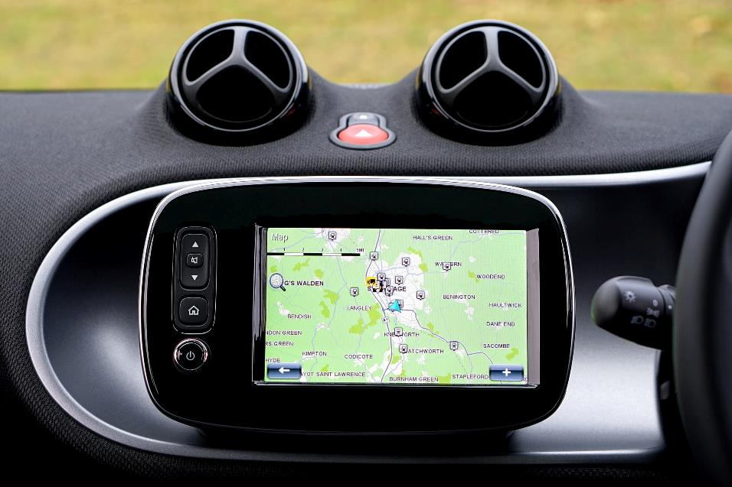
1
The end is the beginning.
Kirkpatrick Foundational Principle
Notes:
Guidelines for what to do and say
Kirkpatrick Foundational Principle #1 is “The end is the beginning.”
Starting with the end in mind is a popular mantra used in many respected methodologies and theories; the Kirkpatricks certainly did not invent this time-tested concept.
Think about a GPS device. For it to work properly, you need the address of your destination. If you want to go to (insert a local example, if you wish) a certain restaurant in Los Angeles, you will get there more quickly if you enter the address, rather than just typing in LA and driving around until you find it.
The same is true of training initiatives. If you are not clear on what business result you are trying to support or what ultimate outcome your key business stakeholders are trying to accomplish, it is unlikely that you will accomplish the goal or meet their expectations.
10

Slide 11
2
Return on expectations (ROE) is the ultimate indicator of value.
re turn on ex·pec·ta·tion
\ri-tərn ȯn ek-spek-tā-shən\ - noun
1. What a successful training initiative delivers to key business stakeholders demonstrating the degree to which their expectations have been satisfied
KIRKPATRICK FOUNDATIONAL PRINCIPLE
Notes:
Guidelines for what to do and say
The second Kirkpatrick Foundational Principle is “Return on Expectations (ROE) is the ultimate indicator of value.”
ROE is (read definition on slide, emphasizing the word “their,” making it clear that we are not imposing what we think are the criteria for success (e.g., % or $).
This is one of the reasons that the U.S. Office of Personnel Management has selected ROE as the ultimate measurement of initiative success.
Here are a few points about ROE:
ROE starts with pre-determined or pre-negotiated targeted Level 4 outcomes. This becomes the “E,” or expectations.
The “RO” is the collaborative and collective effort of all parties and factors that contribute to learning, performance and impact.
Acceptance of ROE as the measurement of success is growing because it is compatible with a teamwork approach. It replaces older isolation-based models.
ROE is about giving credit where credit is due to all contributors to the success of an initiative. Relative contributions of each factor will be determined for mission-critical programs.
ROE focuses initiatives on what is more important. For decades, trainers have unfortunately been providing data that they think is important but that misses the mark for business leaders.
11

Slide 12
3
Business partnership is necessary to bring about positive ROE.
KIRKPATRICK FOUNDATIONAL PRINCIPLE
Notes:
Guidelines for what to do and say
The third Kirkpatrick Foundational Principle is “Business partnership is necessary to bring about positive ROE.”
Training alone will not lead to enough on-the-job application to bring about significant results.
It takes the collective work of a cross-functional team to develop and deliver the right type of training and maximize on-the-job performance. This collective effort is what will deliver the desired Level 4 results.
12

Slide 13
4
Value must be created before it can be demonstrated.
KIRKPATRICK FOUNDATIONAL PRINCIPLE
Notes:
Guidelines for what to do and say
Kirkpatrick Foundational Principle #4 is “Value must be created before it can be demonstrated.”
The common approach over the past 20 years has been to deliver training, then measure later if it “worked.”
The Kirkpatrick Business Partnership Model fills in the critically important missing element, which is tracking if the initiative is working to create the required behavior on the job to yield the desired organizational results.
This gives organizations the chance to make adjustments and realize positive results from the initiatives into which time, money and other resources have already been invested.
Now we will look at the New World Kirkpatrick Model, which helps to guide organizations in creating and demonstrating program value.
13

Slide 14
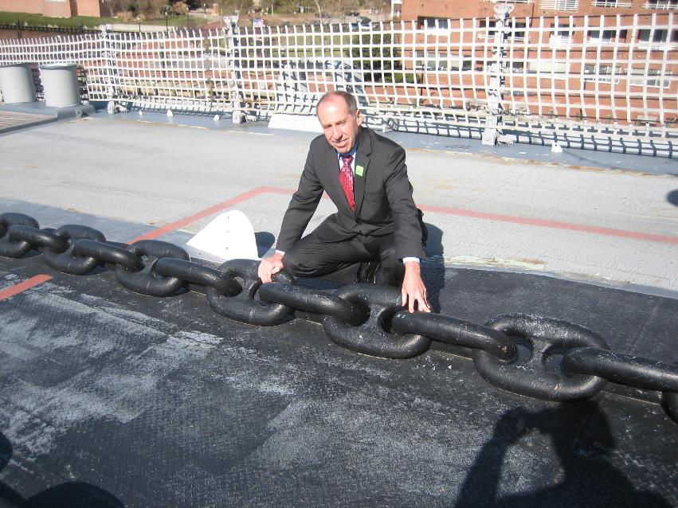
5
A compelling chain of evidence demonstrates your bottom-line value.
KIRKPATRICK FOUNDATIONAL PRINCIPLE
Notes:
This is a picture of Jim on the deck of the USS Wisconsin in Norfolk, VA. It was built in 1943. Each chain link weighs 120 lbs. – the heaviest chain in the world! (You should have seen how surprised the onlookers were when he threw it over his shoulder and started carrying it around- kidding!)
Guidelines for what to do and say
The final Kirkpatrick Foundational Principle is “A compelling chain of evidence demonstrates your bottom-line value.”
14

Slide 15
Notes:
Guidelines for what to do and say
This is an illustration for much of the way training relates to the business. Lots of activity exists, but the narrow focus on developing and delivering learning events leads to unknown and weak results. Too much is left to chance.

Slide 16
Notes:
Guidelines for what to do and say
This picture represents what we call the Kirkpatrick Business Partnership Model. The bridge can be interpreted in two ways. The first, crossing the strategic divide, is the critical connection between learning and all of the other internal business partnerships that must work together to maximize on-the-job application of skills and, subsequently, targeted results. The degree to which these business partnerships work together will largely determine the future of your training function, and the degree to which bottom-line impact is realized.
From a more tactical point of view, this bridge represents the connection between Level 2 (learning) and Level 3 (behavior). The key to reaching Level 4 (results) is to connect learning to application. Application will not happen through world-class training, good intentions or magic. Instead, it is the coordinated work of groups of individuals leveraging our concept of required drivers (see our 2010 article “ROE’s Rising Star” for the strategic and our 2014 whitepaper “The Kirkpatrick Four Levels®: A Fresh Look After 55 Years” for the tactical). Both are free downloads in the Resources tab of kirkpatrickpartners.com. The degree of application will directly influence how quickly and to what degree targeted business outcomes are realized.

Slide 17
Training
Business
Notes:
Guidelines for what to do and say
If you prefer, use this and the following slide instead of the previous two slides.
This slide illustrates what we call “the old training model,” with training on the left (note the sparse vegetation) and the business on the right. The major point to make with this picture (taken in Greece) is that business leaders do not see training as a strategic value proposition to their organization. The little white sailboat crossing the separation is the only real connection between the two. Participants are ferried across to training, then return to their jobs. Training is seen as a cost center, with little impact or credit.

Slide 18
Notes:
Guidelines for what to do and say
This picture, taken near the previous picture, represents what we call the Business Partnership Model. Note the beach area connecting training on the left and business on the right. Collaboration and value creation come to life during all three phases of any major initiative: planning, execution (including drivers at Level 3), and at the end when value is demonstrated and all parties share the ultimate organizational success!
We suggest you use either the bridge or the island pictures, not both, to illustrate your point.

Slide 19
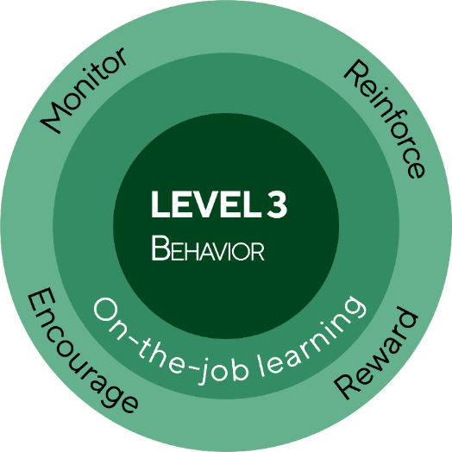
THE NEW WORLD KIRKPATRICK MODEL
LEVEL 1
Reaction
Engagement
Relevance
Customer satisfaction
LEVEL 4
Results
Leading indicators
Desired outcomes
LEVEL 2
Learning
Knowledge
Skills
Attitude
Confidence
Commitment
MONITOR AND ADJUST
Notes:
Guidelines for what to do and say
We took a brief look at the New World Kirkpatrick Model at the beginning of the program. Now we are ready to dig deeper into it. Some of you who have come to this program with many years of training experience may be surprised at how many elements of the four levels are new. This New World Kirkpatrick Model diagram was conceived in 2010 to visually show the importance of and relationship between each of the four levels. We also enhanced each level by adding elements that increase the likelihood of maximizing on-the-job performance and training’s contribution to the bottom line of any organization.
You can see that L1 and L2 are now stacked on top of each other. This is because, in practice, they can and should be assessed simultaneously both during and after training. For instance, a group activity can provide a rich amount of information about how well people are actively participating in the training (Level 1) and able to demonstrate newly developed skills (Level 2). At the end of a program, it is strongly recommended that a participant survey include items that relate to Levels 1 and 2, as well as items that look ahead to Level 3 Behavior and Level 4 Results.
Level 1 includes not just traditional customer satisfaction issues, but also content relevance and participant engagement.
Level 2 now includes confidence to apply and commitment to act rather than stopping at attitude.
Traditional Level 3 is the bulls-eye in the center of the diagram – to what degree are training graduates applying what they learned on the job. New World Level 3 includes the surrounding rings of on-the-job learning, monitoring, reinforcing, encouraging and rewarding. This is because the New World Model is about actually driving and influencing behaviors rather than just hoping they occur. Required drivers are the key to accomplishing organizational results.
Level 4 leading indicators and desired outcomes finish up the diagram. Traditional Level 4 is simply the flag at the top of the mountain. The New World Model basically includes an entire Level 4 mountain rather than just the summit. As we have seen, this allows for monitoring progress towards the top rather than being in the dark about the final outcome.
The large orange box is purposefully hard to ignore because Monitor & Adjust is the role of the training function after formal training is complete. It is their job to track driver execution and new behavior occurrence at L3, and leading indicators at L4, to see if the initiative is moving in the right direction. If not, analysis needs to be done as to why, and adjustments made to the on-the-job activities. From an opposite perspective, Monitor & Adjust also means that it is important to identify those individuals and areas exhibiting above-standard performance and to reinforce and leverage those best practices. Make no mistake -- while Levels 1 and 2 form the foundation of organizational success, the real power is found in the orange! This is where business strategy execution is successful or not.
Participants often ask why this diagram is not a loop, feeding back from L4 to L1. The reason is because an ASTD study showed that when results are not achieved, and the leading indicator flags are not marching up the slope as they should, training is the problem only 10% of the time. While formal training often needs fine tuning, it is seldom necessary to send employees all the way back to the classroom. Interventions within the orange box will almost always correct problems and barriers to progress and ultimate success.
This diagram leaves no doubt that no shortcut exists from Levels 1 and 2 straight to Level 4. This is where the level of effort must be discussed in order to maximize the results of your initiatives. This is a critical conversation because the organization often wants to put the sole responsibility of solving business problems on training, but these problems cannot be solved with training alone.
What are your thoughts about the new diagram?

Slide 20
Contact Us
www.kirkpatrickpartners.com
(770) 302-3500
information@kirkpatrickpartners.com

